Slide 1
Predicting Protein Secondary Structure by a Support Vector Machine Based on a New Coding Scheme
Long-Hui Wang, Juan Liu,
Yan-Fu Li, Huai-Bei Zhou
School of Computer, Wuhan University, Wuhan 430079, China
International School of Software, Wuhan University, Wuhan 430072, China
Genome Informatics 15(2): 181-190 (2004)

Slide 2
Abstract (1/2)
Protein structure prediction is one of the most important problems in modern computational biology. Protein secondary structure prediction is a key step in prediction of protein tertiary structure. There have emerged many methods based on machine learning techniques, such as neural networks (NN) and support vector machine (SVM) etc., to focus on the prediction of the secondary structures.

Slide 3
Abstract (2/2)
In this paper, a new method was proposed based on SVM. Different from the existing methods, this method takes into account of the physical-chemical properties and structure properties of amino acids. When tested on the most popular dataset CB513, it achieved a Q₃ accuracy of 0.7844, which illustrates that it is one of the top range methods for protein of secondary structure prediction.

Slide 4
DSSP
H : alpha-helix
G : 3₁₀-helix
I : pi-helix
E : beta-strand
B : isolated beta-bridge
T : turn
S : bend
- : rest

Slide 5
Three Reduced States
(1) H, G and I to H; E to E; the rest to C
(2) H, G to H; E, B to E; the rest to C
(3) H, G to H; E to E; the rest to C
(4) H to H; E, B to E; the rest to C
(5) H to H; E to E; the rest to C

Slide 6
Materials
RS126 : 23,411 residues, 31.16% helix, 23.20% sheet, and 45.63% coil
CB513 : 84,034 residues, 34.30% helix, 22.54% sheet, and 43.16% coil

Slide 7
Prediction Accuracy Assessments
Q₃ = ( P_{α} + P_{β} + P_{coil} ) / N
P_{α} : the number of correctly predicted secondary structures of type α
Q_{α} = P_{α} / total number of residue in H
Q_{β} = …
Q_{coil} = …

Slide 8
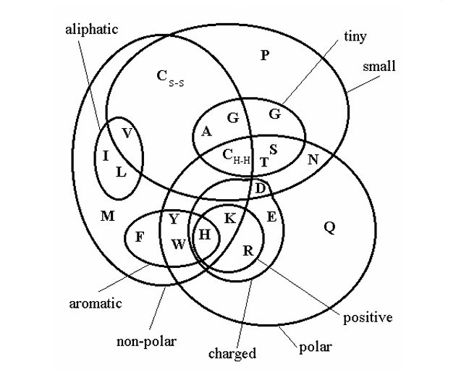
\\.PSF\Untitled\paper用圖\擷圖_1.png

Slide 9
Coding Scheme 1
Hydrophobic character
I (4.5); V(4.2); L(3.8); F(2.8); C(2.5); M(1.9); A(1.8); G(0.4);
T(-0.7); S(-0.8); W(-0.9); Y(-1.3);
P(-1.6); H(-3.2); E(-3.5); N(-3.5);
Q(-3.9); N(-3.5); K(-3.9); R(4.0).

Slide 10
Coding Scheme 2
3-dimension vector
f_{ij} = n_{ij} / N_{i}
f_{j} = N_{j} / N_{t}
n_{ij} : total number of ith that has jth conformation
N_{i} : total number of the ith amino acid residues
N_{j} : total number of jth conformation
N_{t} : total number of residues

Slide 11
Coding Scheme 2 (cont.)
P_{ij} = f_{ij} / f_{j} , i = 1, …, 20,
j = 1,…, 3
ex: P_{i1} > 1 ,
the ith residue has the propensity to form alpha-helix conformation

Slide 12
Coding Scheme 3
Combine scheme 1 and 2, use a vector of 4-dimension

Slide 13
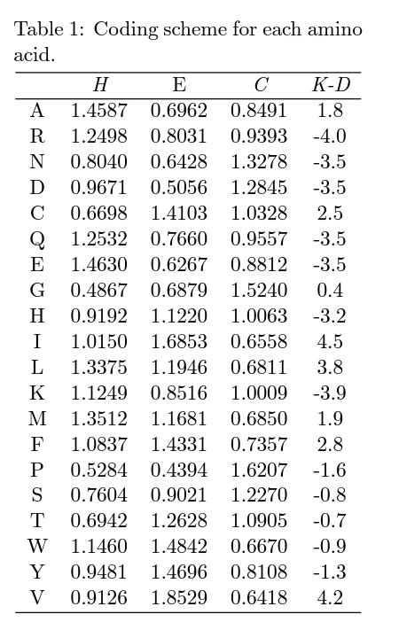

Slide 14
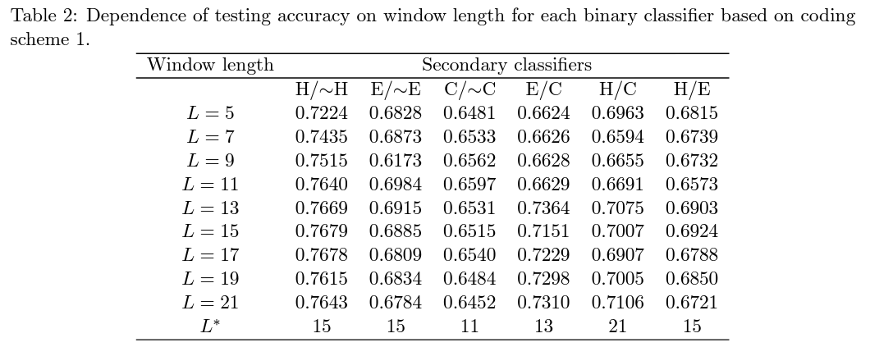
Choose a Window Length(1/3)

Slide 15
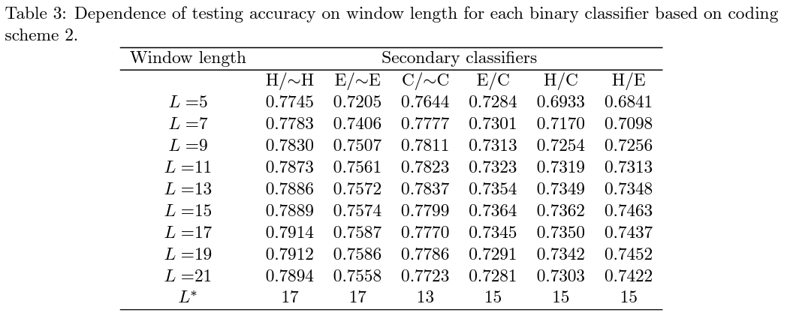
Choose a Window Length(2/3)

Slide 16
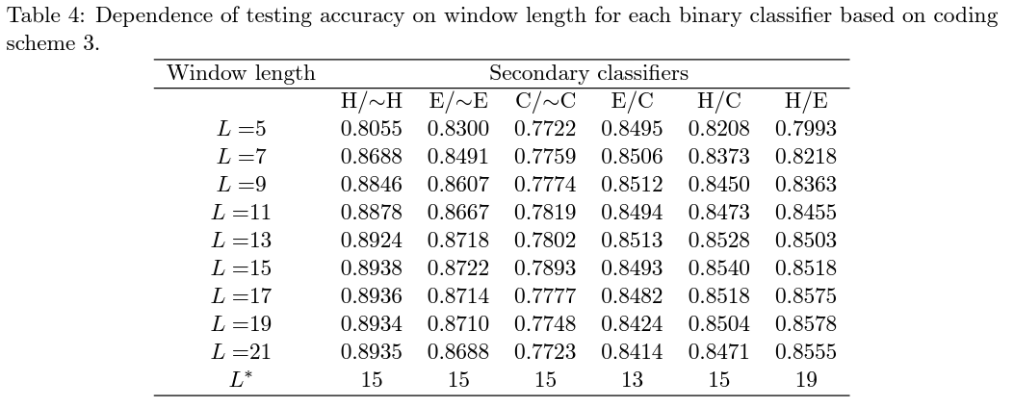
Choose a Window Length(3/3)

Slide 17
Designing the Tertiary Classifiers (1/2)
SVM_TREE1(H/~H, E/C)
SVM_TREE2(E/~E, C/H)
SVM_TREE3(C/~C, H/E)

Slide 18
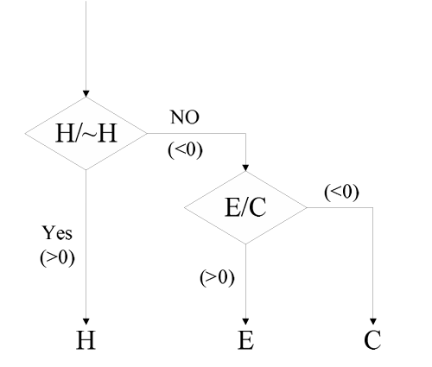
SVM_TREE1

Slide 19
Designing the Tertiary Classifiers (2/2)
SVM_D1
SVM_D2
SVM_D3

Slide 20
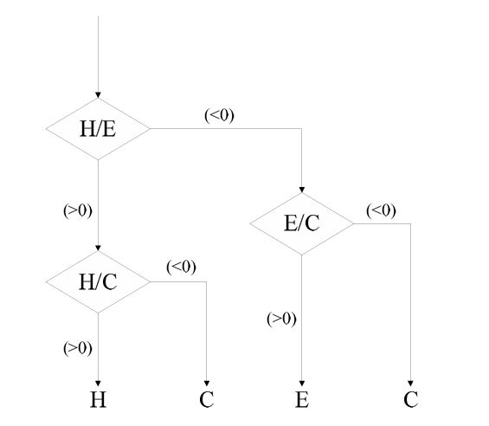
SVM_D1

Slide 21
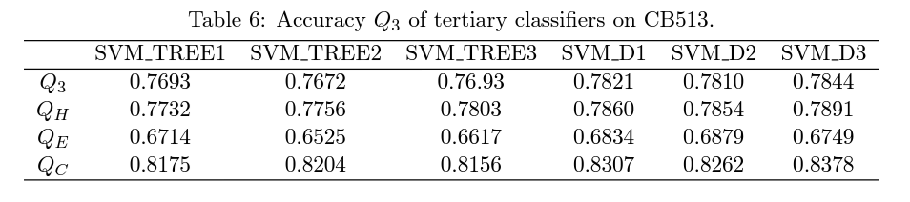
Results and Conclusion
One-versus-one classifiers are more accurate than one-versus-rest classifiers because the one-versus-rest scheme often needs to deal with two data sets with very different sizes

